Slide 1
Heterogeneous Treatment Effect Models
Julian Hsu

Slide 2
Overview
This presentation covers the general problem of estimating heterogeneous treatment effects (HTE) and how it differs from ATE/ATET estimation.
We will briefly cover a few models:
Double Machine Learning following Semenova et al. (2021)
Generalized Random Forests - Causal Forests
Proxy models
Wrap up with a simulation demonstration and summary of Heterogeneous Residuals

Slide 3
Why do we care about heterogeneity?
Heterogeneous treatment effects (HTE) allow leaders to make more customer-centric decisions, allowing better optimization across performance across products and services.
For example, if we find that Amazon customers with high spending are more delighted from Audible trials, then Audible trials can be targeted to those customers.
For scientists, HTE can give statistically insignificant a “second wind” if we believe that HTE averaged into something near zero.

Slide 4
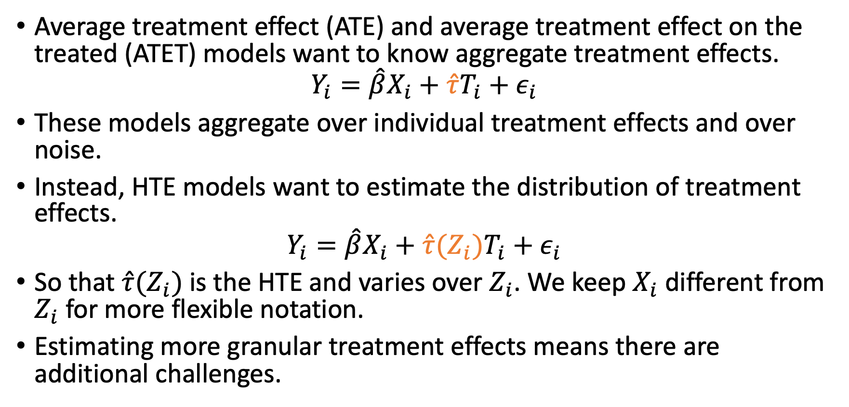
HTE vs ATE/ATET
Average treatment effect (ATE) and average treatment effect on the treated (ATET) models want to know aggregate treatment effects.
$$Y_{i}=\hat{β}X_{i}+\hat{τ}T_{i}+ε_{i}$$
These models aggregate over individual treatment effects and over noise.
Instead, HTE models want to estimate the distribution of treatment effects.
$$Y_{i}=\hat{β}X_{i}+\hat{τ}(Z_{i})T_{i}+ε_{i}$$
So that $\hat{τ}(Z_{i})$is the HTE and varies over $Z_{i}$. We keep $X_{i}$ different from $Z_{i}$ for more flexible notation.
Estimating more granular treatment effects means there are additional challenges.
Notes:
Note that inference and standard errors is *required* for HTE models, just like for ATE/ATET models.

Slide 5
HTE ideal experiment
For ATE/ATET, the ideal is to randomize across the population.
For HTE, the ideal is to randomize for each individual. (logistically impossible)
How do we distinguish between individual-level treatment effects and statistical noise?
Functional form assumptions are crucial to estimating HTE
Notes:
Statistical inference for ATE/ATET estimates is based on the distribution of error around the average estimate.
The challenge is getting a distribution around an individual estimate.
The solution is to rely on either model specifications or bootstrapping-esque methods.

Slide 6
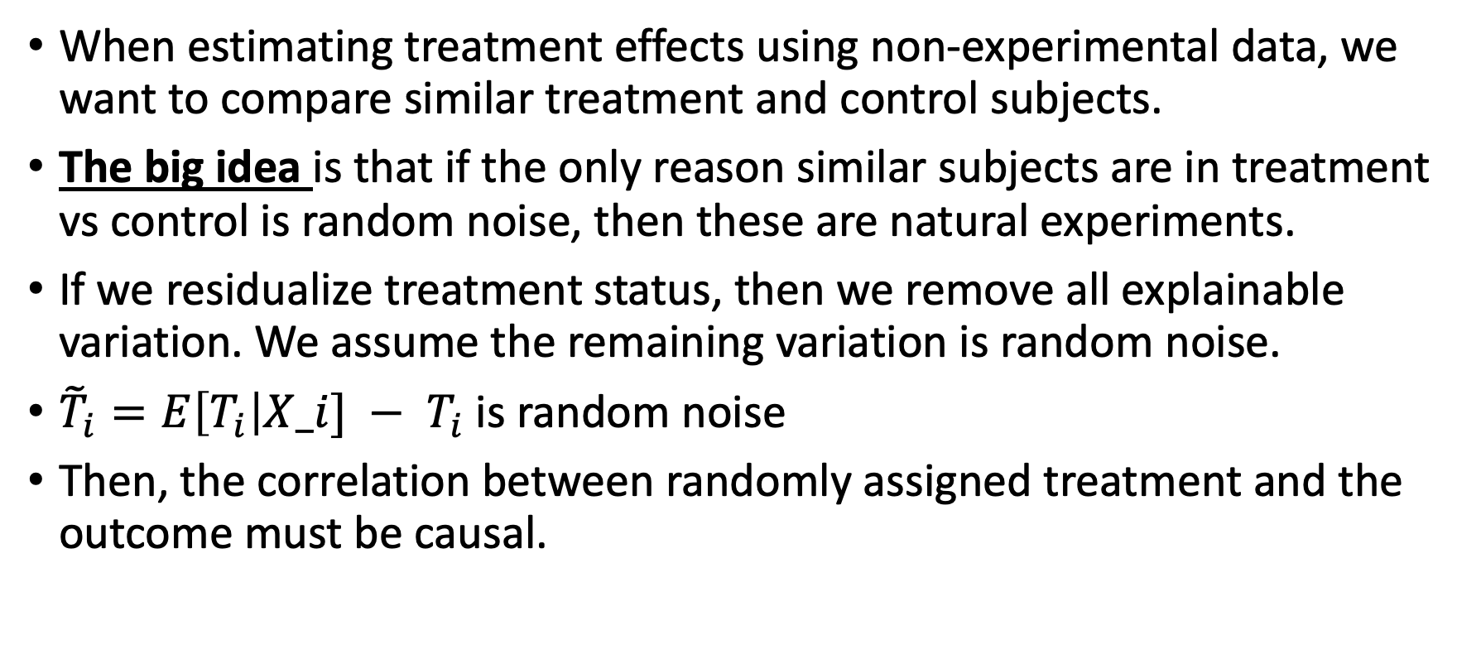
Role of residualization for causal inference
When estimating treatment effects using non-experimental data, we want to compare similar treatment and control subjects.
The big idea is that if the only reason similar subjects are in treatment vs control is random noise, then these are natural experiments.
If we residualize treatment status, then we remove all explainable variation. We assume the remaining variation is random noise.
${{\tilde{T}}_{i}=E\left[T_{i}\right|X_i] − T}_{i}$is random noise
Then, the correlation between randomly assigned treatment and the outcome must be causal.

Slide 7
Some HTE Models

Slide 8
Support over use cases
 | Categorical/Binary Treatments | Continuous Treatments | Panel Data
Linear-Style Models | Yes | Yes | Yes
Generalized Random Forests | Yes | No | Sort of
Proxy Models (can be linear or non-linear) | Yes | No | Sort of

Slide 9
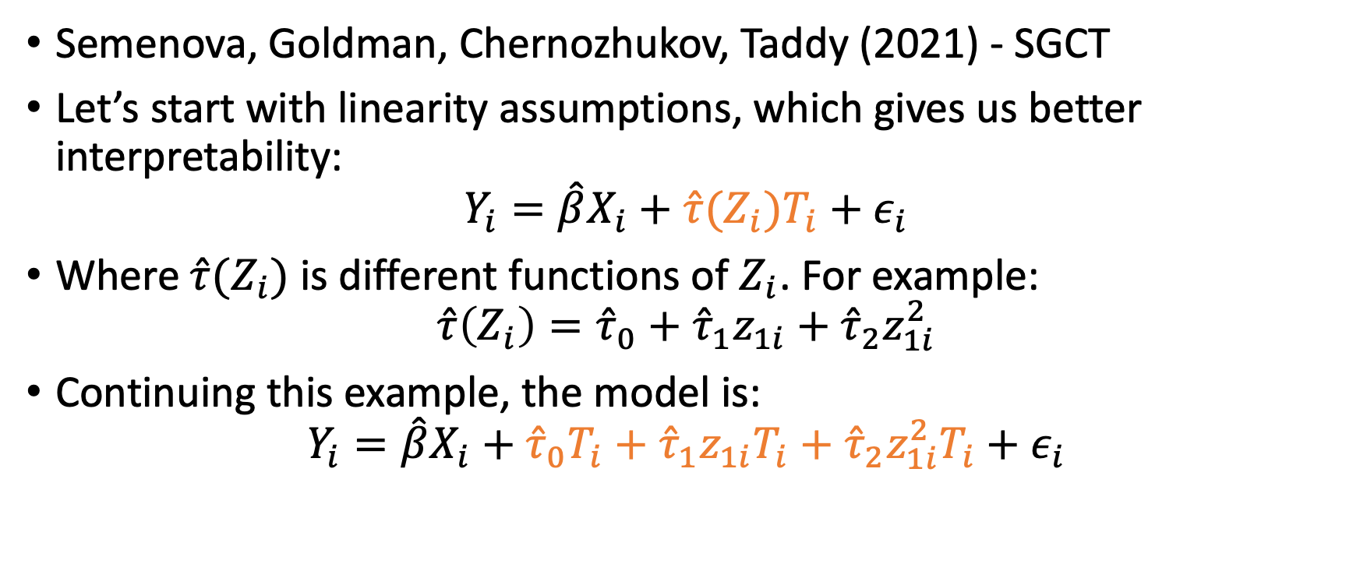
1: Linear-Style Models
Semenova, Goldman, Chernozhukov, Taddy (2021) - SGCT
Let’s start with linearity assumptions, which gives us better interpretability:
$$Y_{i}=\hat{β}X_{i}+\hat{τ}(Z_{i})T_{i}+ε_{i}$$
Where$\hat{τ}(Z_{i})$ is different functions of $Z_{i}$. For example:
$$\hat{τ}\left(Z_{i}\right)={\hat{τ}}_{0}+{\hat{τ}}_{1}z_{1i}+{\hat{τ}}_{2}z_{1i}^{2}$$
Continuing this example, the model is:
$$Y_{i}=\hat{β}X_{i}+{\hat{τ}}_{0}T_{i}+{\hat{τ}}_{1}z_{1i}T_{i}+{\hat{τ}}_{2}z_{1i}^{2}T_{i}+ε_{i}$$

Slide 10
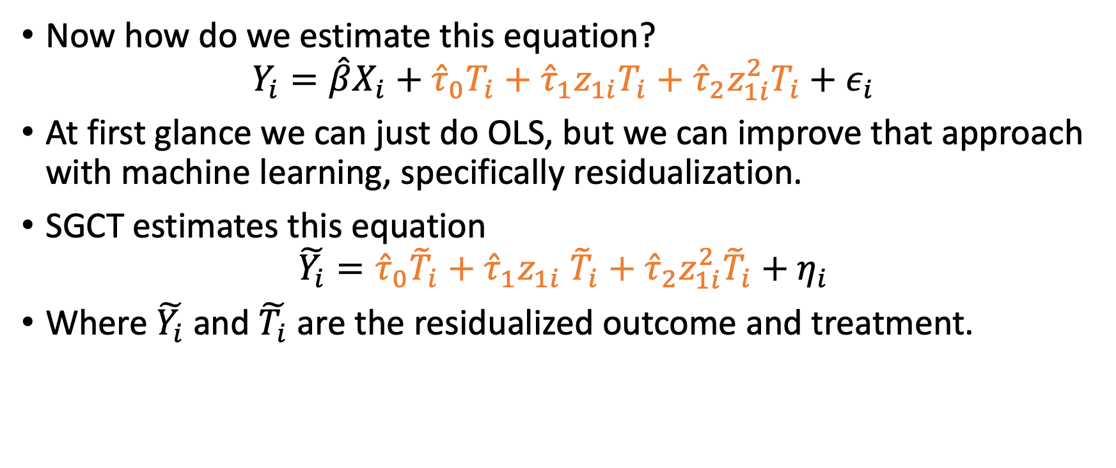
SGCT uses residualization
Now how do we estimate this equation?
$$Y_{i}=\hat{β}X_{i}+{\hat{τ}}_{0}T_{i}+{\hat{τ}}_{1}z_{1i}T_{i}+{\hat{τ}}_{2}z_{1i}^{2}T_{i}+ε_{i}$$
At first glance we can just do OLS, but we can improve that approach with machine learning, specifically residualization.
SGCT estimates this equation
$$\tilde{Y_{i}}={\hat{τ}}_{0}{\tilde{T}}_{i}+{\hat{τ}}_{1}z_{1i} {\tilde{T}}_{i}+{\hat{τ}}_{2}z_{1i}^{2}{\tilde{T}}_{i}+η_{i}$$
Where $\tilde{Y_{i}}$ and $\tilde{T_{i}}$ are the residualized outcome and treatment.

Slide 11
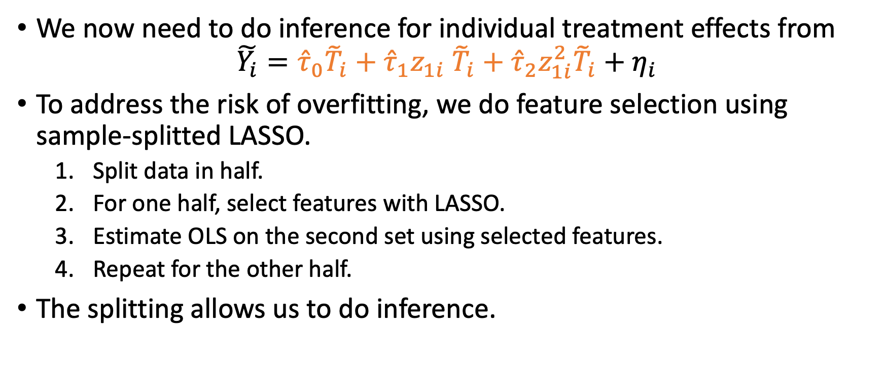
SGCT – HTE and inference
We now need to do inference for individual treatment effects from
$$\tilde{Y_{i}}={\hat{τ}}_{0}{\tilde{T}}_{i}+{\hat{τ}}_{1}z_{1i} {\tilde{T}}_{i}+{\hat{τ}}_{2}z_{1i}^{2}{\tilde{T}}_{i}+η_{i}$$
To address the risk of overfitting, we do feature selection using sample-splitted LASSO.
Split data in half.
For one half, select features with LASSO.
Estimate OLS on the second set using selected features.
Repeat for the other half.
The splitting allows us to do inference.
Notes:
The standard error is calculated via the Delta method.
We can use OLS to estimate the above equation if:
There are few dimensions of heterogeneity (ie $g\left(Z_{i}\right)$is low dimensional); or
We are interested in specific dimensions of heterogeneity (ie we only want to know HTE across account tenure)

Slide 12
2: Generalized Random Forests (GRF)
Causal forests are a special class of generalized random forests, which we will discuss here.
Generalized random forests use “honest trees” which allow inference of forest-based models
Compared to linear-style model, GRF uses a non-parametric approach to estimating HTE.
Similar in spirit to kernel-weighted methods

Slide 13
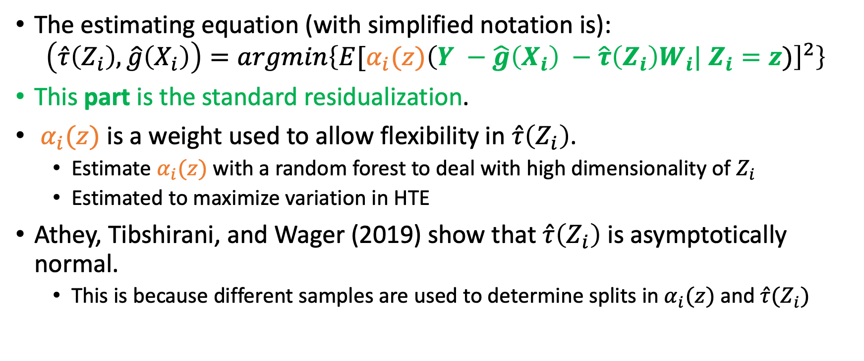
GRF – Causal Forest Objective Function
The estimating equation (with simplified notation is):
$$\left(\hat{τ}\left(Z_{i}\right), \hat{g}\left(X_{i}\right)\right)=argmin\left\{E[α_{i}(z){\left(Y −\hat{g}\left(X_{i}\right) −\hat{τ}{\left(Z_{i}\right)W}_{i}| Z_{i}=z)\right]}^{2}\right\}$$
This part is the standard residualization.
$α_{i}(z)$ is a weight used to allow flexibility in $\hat{τ}\left(Z_{i}\right)$.
Estimate $α_{i}(z)$ with a random forest to deal with high dimensionality of $Z_{i}$
Estimated to maximize variation in HTE
Athey, Tibshirani, and Wager (2019) show that $\hat{τ}\left(Z_{i}\right)$ is asymptotically normal.
This is because different samples are used to determine splits in $α_{i}(z)$ and $\hat{τ}(Z_{i})$
Notes:
Standard errors and confidence intervals are available based on a bootstrap/jackknife approach.
Bootstrap/Jackknife approach: Intuitively, estimate the distribution in $\hat{τ}(z)$ when $z$ is removed from the sample

Slide 14
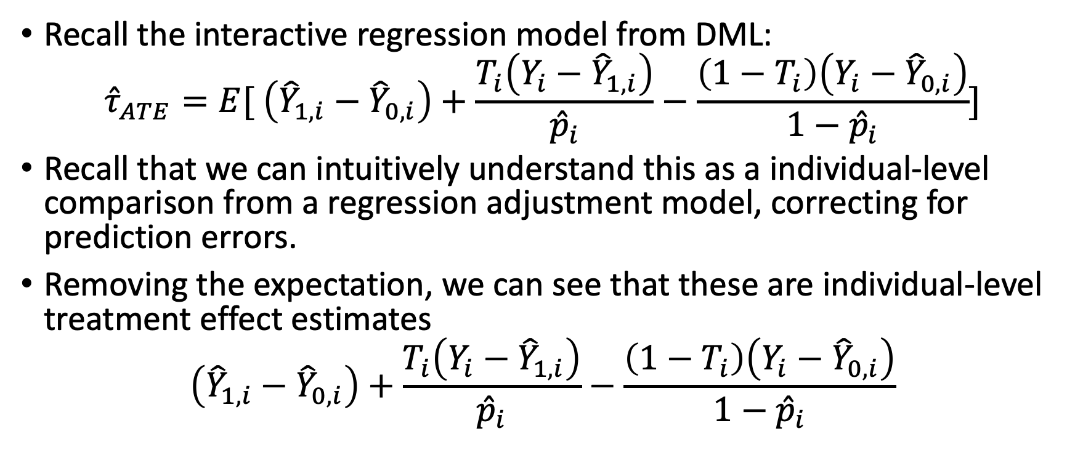
3: Proxy methods
Recall the interactive regression model from DML:
$${\hat{τ}}_{ATE}=E[ \left({\hat{Y}}_{1,i}−{\hat{Y}}_{0,i}\right)+\frac{T_{i}\left(Y_{i}−{\hat{Y}}_{1,i}\right)}{{\hat{p}}_{i}}−\frac{\left(1−T_{i}\right)\left(Y_{i}−{\hat{Y}}_{0,i}\right)}{1−{\hat{p}}_{i}}]$$
Recall that we can intuitively understand this as a individual-level comparison from a regression adjustment model, correcting for prediction errors.
Removing the expectation, we can see that these are individual-level treatment effect estimates
$$\left({\hat{Y}}_{1,i}−{\hat{Y}}_{0,i}\right)+\frac{T_{i}\left(Y_{i}−{\hat{Y}}_{1,i}\right)}{{\hat{p}}_{i}}−\frac{\left(1−T_{i}\right)\left(Y_{i}−{\hat{Y}}_{0,i}\right)}{1−{\hat{p}}_{i}}$$
Notes:
We can do the same thing with IPW or other doubly robust methods to get noisy individual treatment effects

Slide 15
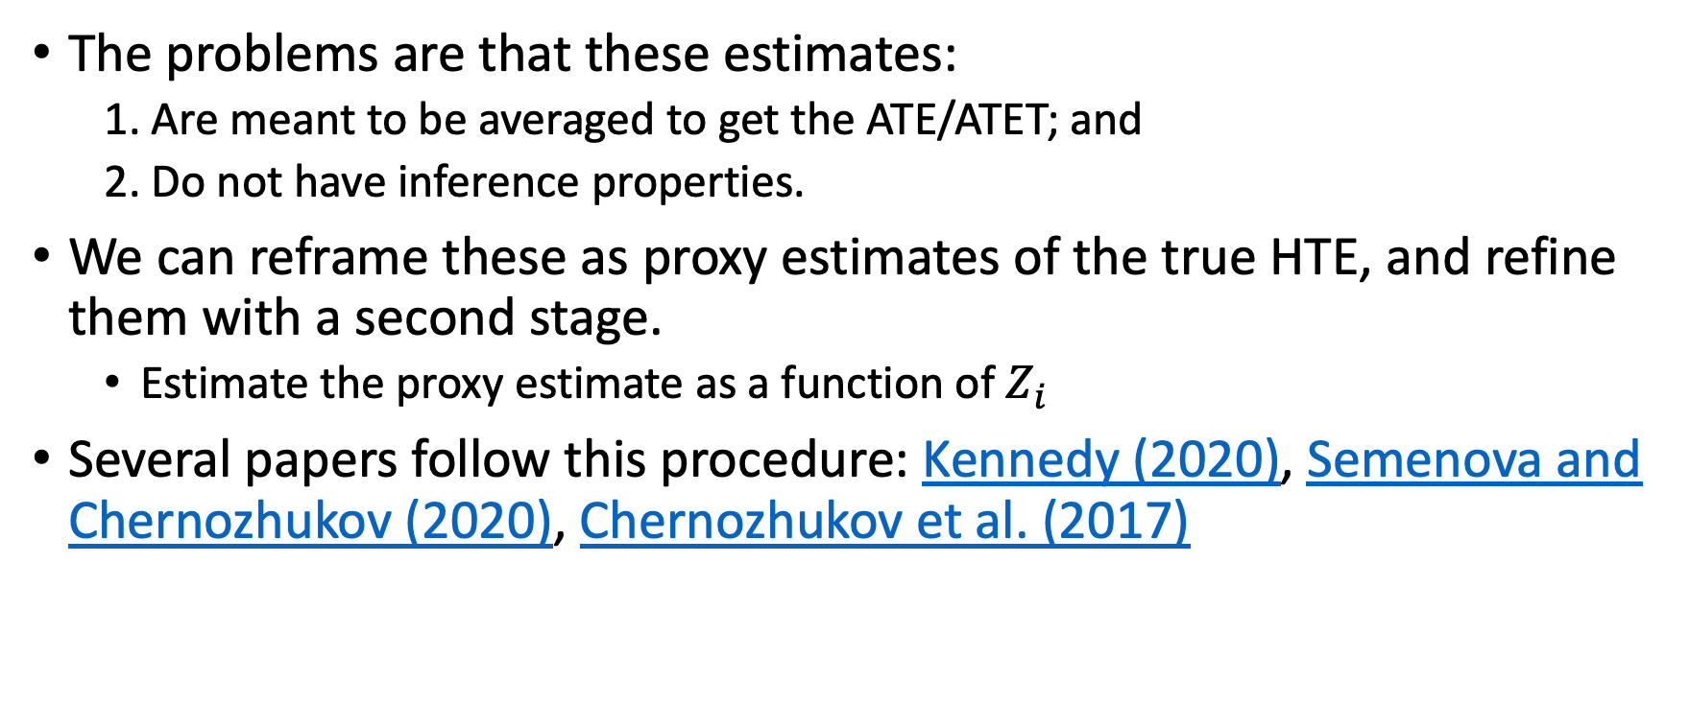
Applying inference to the individual estimates
The problems are that these estimates:
1. Are meant to be averaged to get the ATE/ATET; and
2. Do not have inference properties.
We can reframe these as proxy estimates of the true HTE, and refine them with a second stage.
Estimate the proxy estimate as a function of $Z_{i}$
Several papers follow this procedure: Kennedy (2020), Semenova and Chernozhukov (2020), Chernozhukov et al. (2017)
Notes:
You *could* do bootstrapping of the individual-level estimates, but that would be very computationally intensive procedure.

Slide 16
Simulation Study

Slide 17
Context
We covered three types of models:
Linear-Style Models - SGCT
GRF
Proxy Model
We compare performance using simulation evidence, where we can change the true HTE function
For simplicity, there is only one feature in these simulations.
We will find that the functional form assumption has a material impact on performance

Slide 18
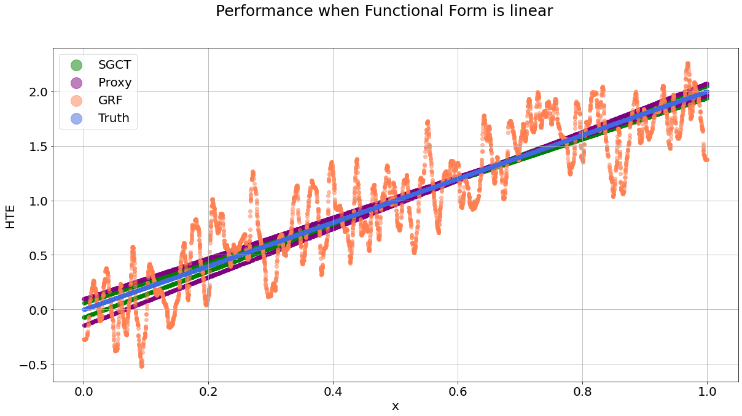
First Example – Linearity
$HTE\left(x\right)=2x$

Slide 19
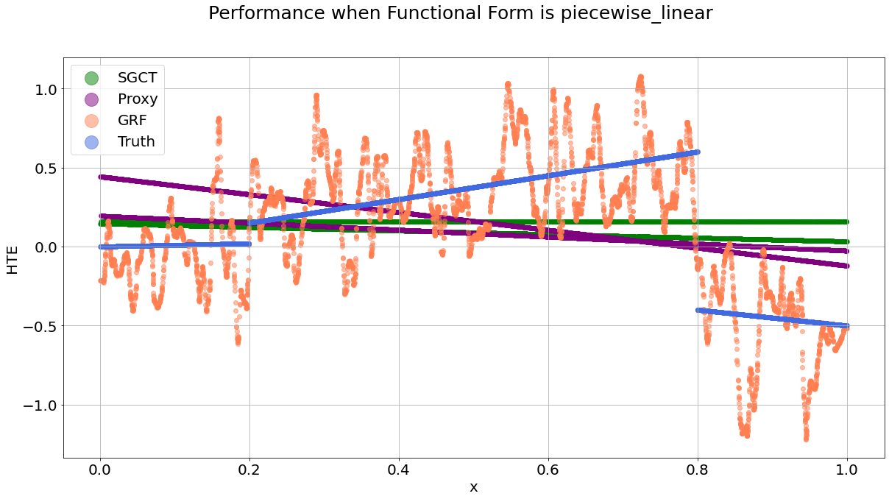
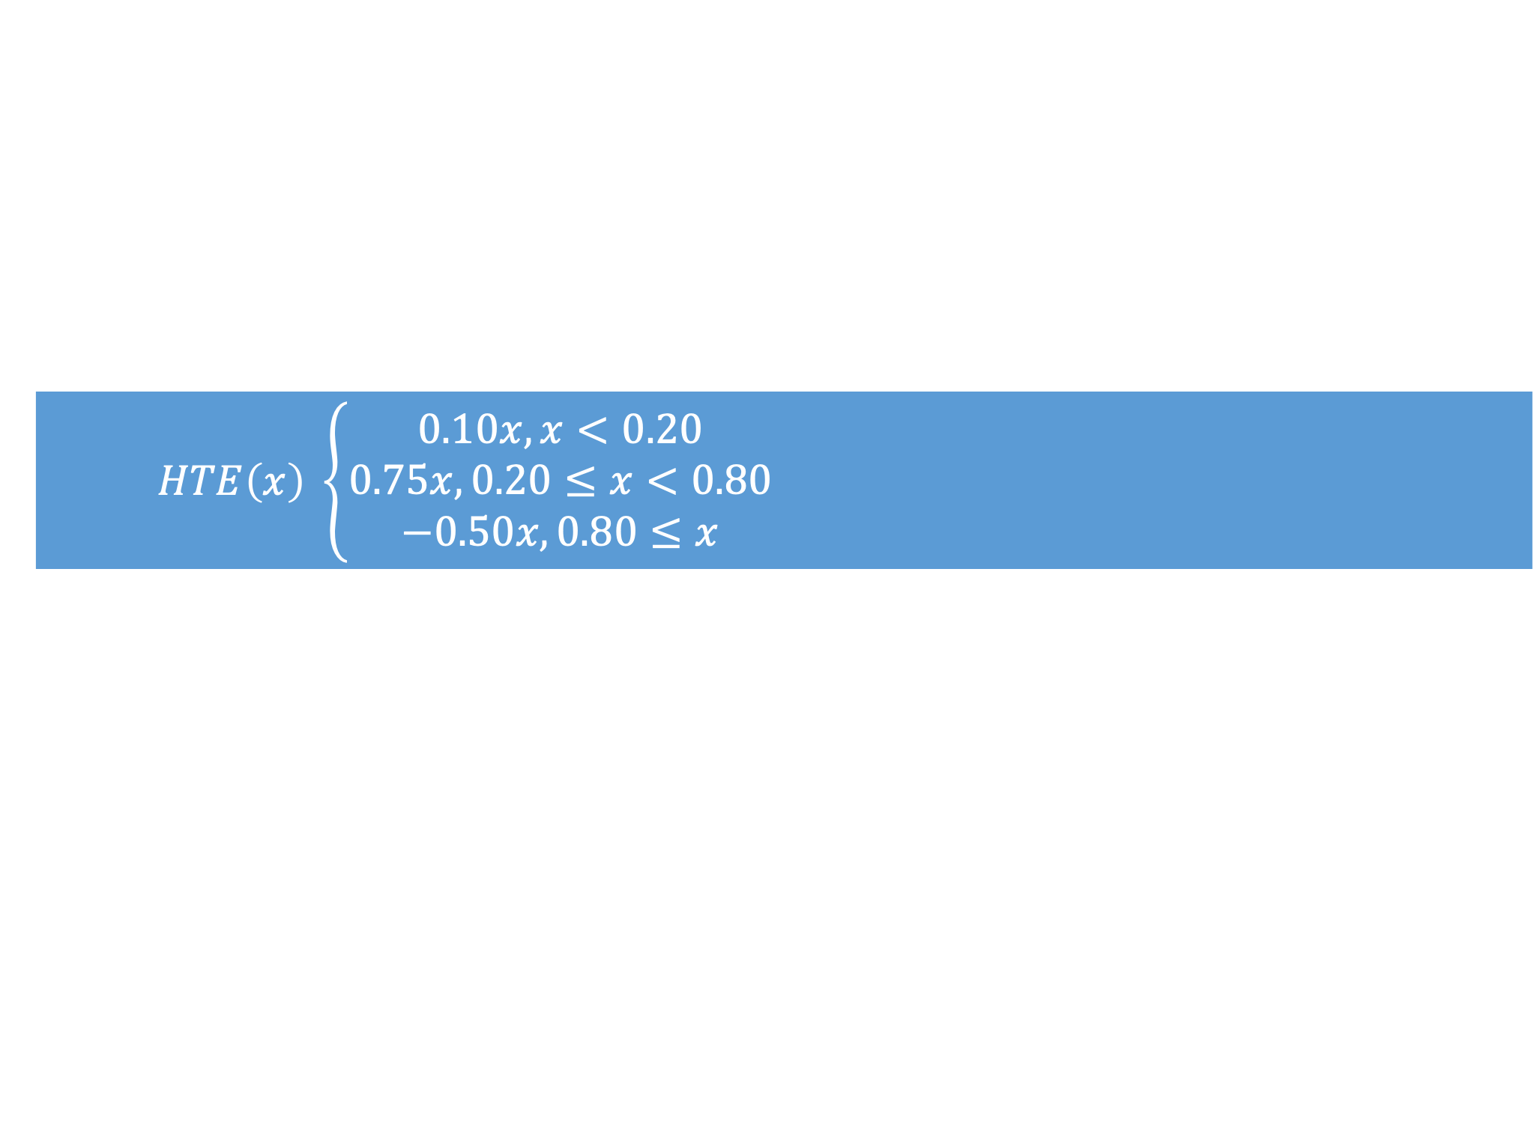
Second Example – Piece-wise
$HTE\left(x\right) \left\{\begin{aligned}0.10x, x<0.20 \\ 0.75x, 0.20≤x<0.80 \\ −0.50x, 0.80≤x\end{aligned}\right.$

Slide 20
Takeaways and Conclusion
Today, we covered the additional complexities and challenges of estimating HTE and did a demonstration with simulated data
The functional form assumption (linear, non-parametric) has a material impact on whether you correctly estimate the HTE functions.
The more granular you want HTE estimates to be, the more data you need.

Slide 21
How can we improve on the linear style models?

Slide 22
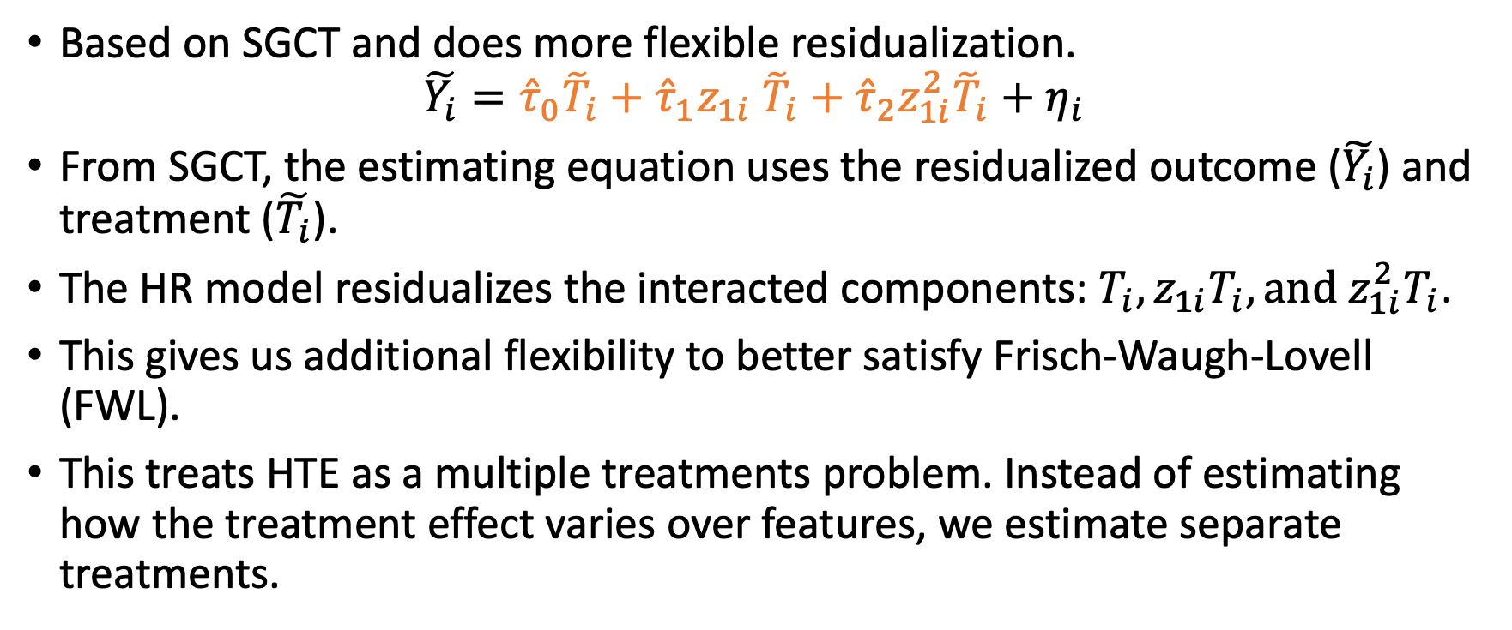
Heterogeneous residuals (HR)
Based on SGCT and does more flexible residualization.
$$\tilde{Y_{i}}={{\hat{τ}}_{0}{\tilde{T}}_{i}+\hat{τ}}_{1}z_{1i} {\tilde{T}}_{i}+{\hat{τ}}_{2}z_{1i}^{2}{\tilde{T}}_{i}+η_{i}$$
From SGCT, the estimating equation uses the residualized outcome ($\tilde{Y_{i}}$) and treatment ($\tilde{T_{i}}$).
The HR model residualizes the interacted components: $T_{i}, z_{1i}T_{i},{\text{and} z_{1i}^{2}T}_{i}$.
This gives us additional flexibility to better satisfy Frisch-Waugh-Lovell (FWL).
This treats HTE as a multiple treatments problem. Instead of estimating how the treatment effect varies over features, we estimate separate treatments.
Notes:
There is a minor point here about how reasonable it is to condition on the squared version of a variable. However, we can make the same argument if instead of $z_{1i}$, we had $z_{2i}$. Note the argument ${\tilde{T}}_{i}$ contains information about the other covariates does not hold because by construction it has to be uncorrelated with other features.
The linear expectation is done because OLS implicitly does a linear expectation for residualization. You can see this yourself if you were to use OLS (without any cross-fitting) in a simple DML model.

